Slide 1
Leveraging BIRT Reporting in Your Applications
Jason Weathersby
BIRT Evangelist, Actuate Corp.

Slide 2
Agenda
What is BIRT
Scripting BIRT
Deploying BIRT Reports
BIRT APIs
Extension Points

Slide 3
What Is BIRT?

Slide 4
What is the BIRT Project?
Business Intelligence and Reporting Tools based on Eclipse
Initially focused on embedded reporting for Java developers
Three initial components as part of BIRT project
Eclipse
Report
Designer
Custom
Report
Designer…
Report Engine
Custom
Services…
Data Transform.
Services
Charting
Services
1
3
HTML
PDF
Print
XML
…
2
Report Design Engine
Generation
Services
Presentation
Services
XML
Report
Design
Data
Report
Document

Slide 5
BIRT What is available
birt-report-framework-xyz
  BIRT Designer Eclipse Plug-in
birt-rcp-report-designer-xyz
  RCP Version of the BIRT Designer
birt-runtime-xyz
  BIRT web application
  report engine runtime and examples
  chart engine runtime.
birt-charts-xyz
  Stand alone chart engine plug-ins.
Samples

Slide 6
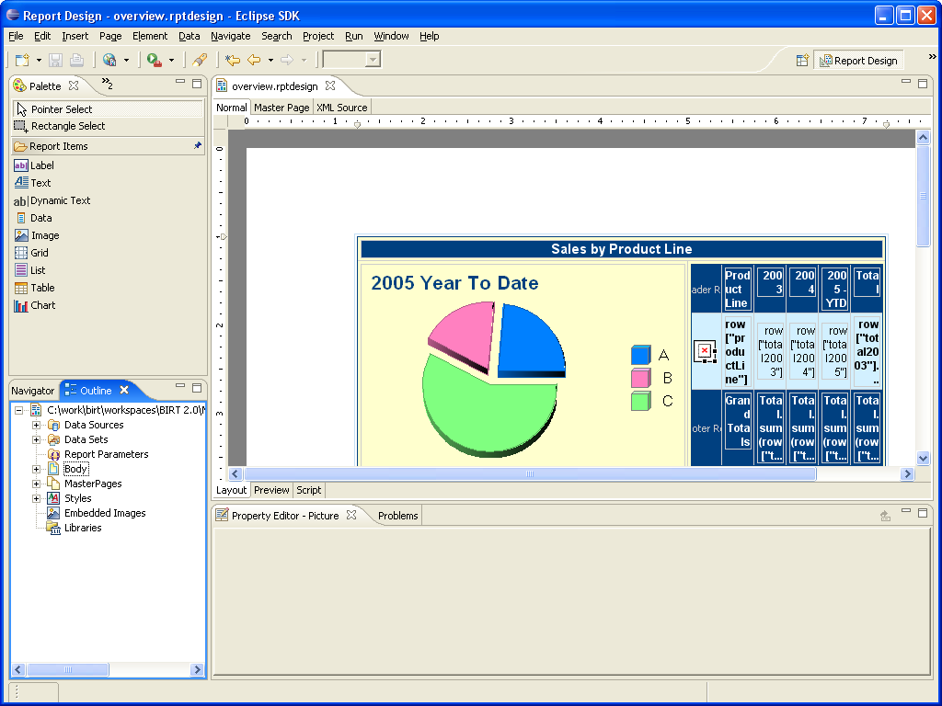
BIRT Designer

Slide 7
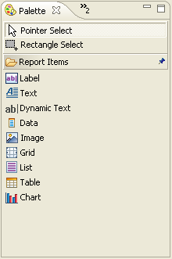
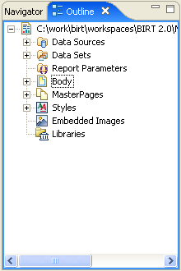
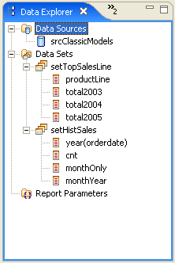
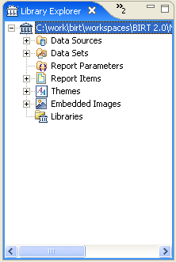
BIRT Views

Slide 8
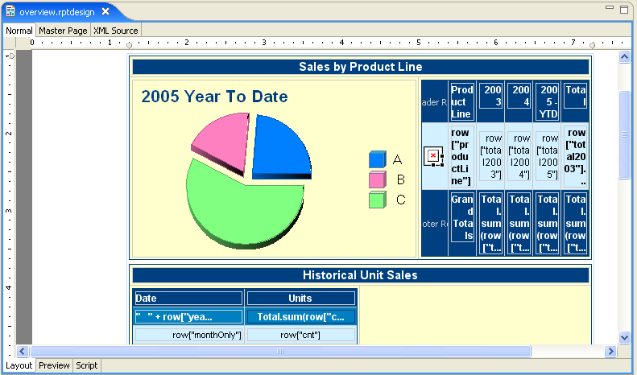
BIRT Editor

Slide 9
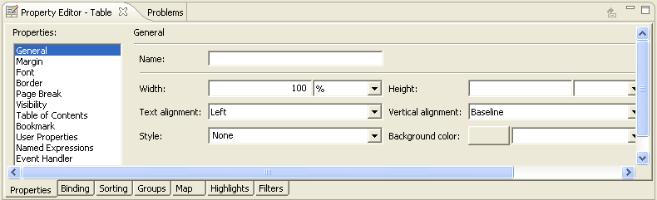
Property Editor View

Slide 10
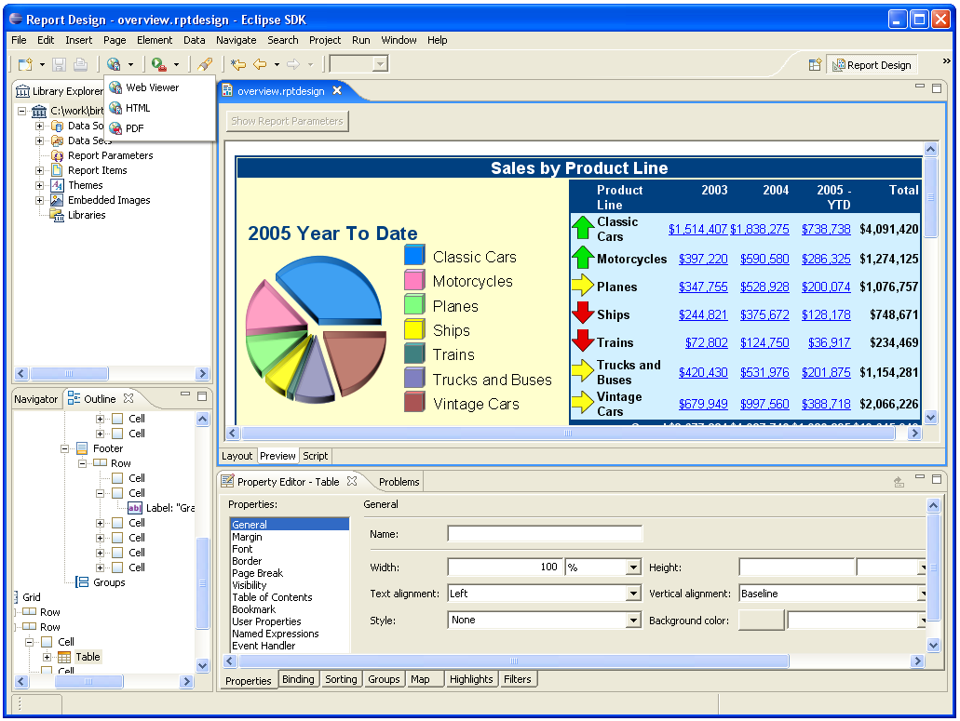
Previewing BIRT Reports

Slide 11
BIRT Generation and Render Pipeline
Report
Designer
Design
Engine
Optional Java Events
JavaScript Events
RptDesign
XML
Design File
Generation Phase
Presentation Phase
Paginated HTML
PDF
CSV
Report Engine
JDBC
XML
FlatFile
Scripted
RptDocument
Report
Document
optional

Slide 12
Scripting
BIRT JavaScript
  Based on Mozilla Rhino
  - This is Server Side Scripting not Browser Based Scripting
  Two types of Scripting
    Expression Scripts - Scripts that return a data value. Available in the Expression Builder.
    Element Scripts – JavaScript methods that are called on events. Customize the behavior of the Report. Available in the Script view. Context of when the event occurs is important.
    Both types have access to the same scripting objects.

Slide 13
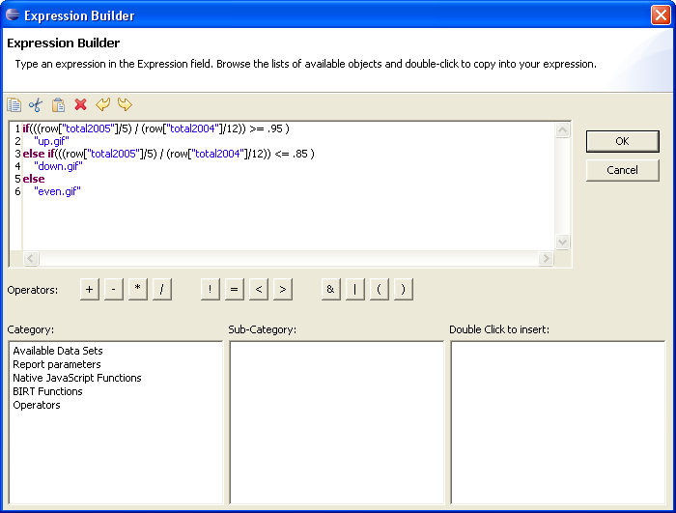
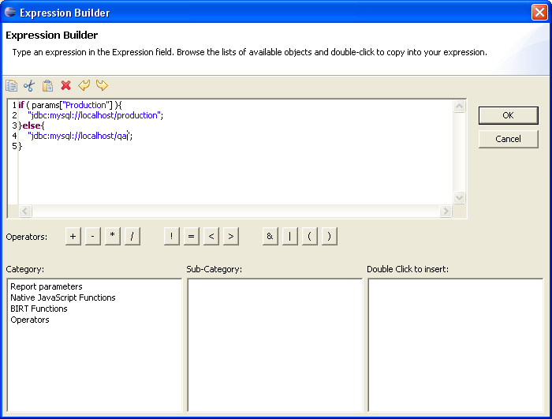
Expression Scripting

Slide 14
Expression Scripting - Locations
Creating the display value for a report item
Creating a computed field in Data Explorer
Specifying a filter condition
Specifying a data series for a chart
Specifying a map condition
Specifying a highlight condition
Specifying a group key
Specifying a hyperlink
Specifying the URI for an image
Specifying dynamic data in a text control

Slide 15
Expression Scripts
Reference Objects
  Data Set Columns
  Parameter Values
  Other Report Elements
  Configuration variables
  Constants
  User-defined variable

Slide 16
Scripting Functions
String Functions
Date/Time Functions
Math Functions
Conversion Functions
Financial Functions
Statistical Functions
Aggregate Functions
User Created Functions
Java Code

Slide 17
BIRT Event Model
JavaScript Events
Generation Phase
Presentation Phase
Report Level
Initialize
beforeFactory
afterFactory
Data Source/Set
beforeOpen
afterOpen
onFetch
beforeClose
afterClose
Report Level
beforeRender
afterRender
Report Element
onRender
Report Element
onPrepare
onCreate

Slide 18
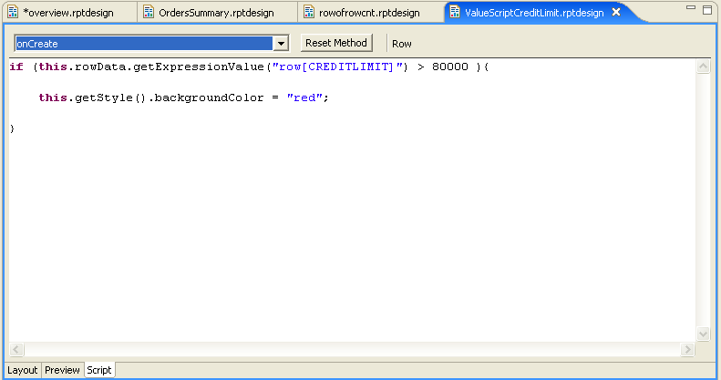
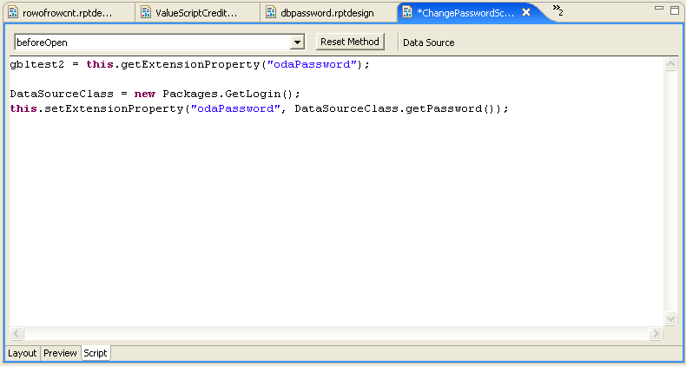
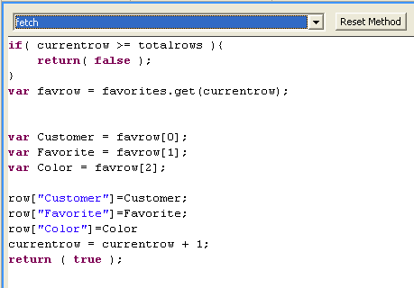
Element Scripting

Slide 19
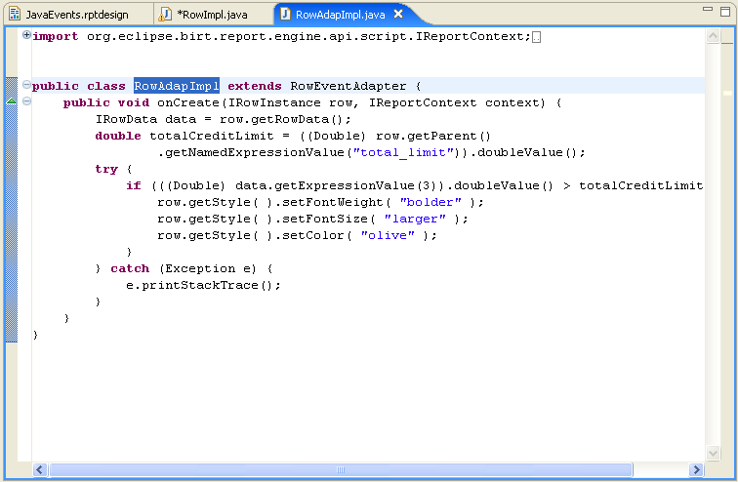
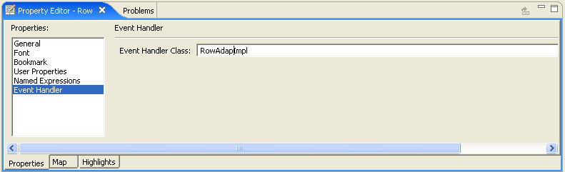
Element Event Handlers using Java
A set of Adapters are supplied that allow all event handlers to be built in Java.
The class is a property of the element.
Can be debugged with JDT using the BIRT Report Configuration.

Slide 20
Deploying BIRT
Paginated HTML, PDF, TOC, Bookmarks, CSV
BIRT Report Web Application
  Standalone Web Application for running and viewing reports
  Delivered in birt-runtime as Web Viewer Example
  In the Designer BIRT uses embedded Tomcat for previewing, where the Birt Viewer is a Plugin
Report Engine API
  Covered in the API section of the presentation
Eclipse Plugin
J2EE AS
Web Viewer
Web Viewer
Java Application
ReportEngine
ReportEngine
ReportEngine
RptDesign
XML
Design File
RptDocument
Report
Document
RptDesign
XML
Design File
RptDocument
Report
Document
RptDesign
XML
Design File
RptDocument
Report
Document

Slide 21
BIRT Web Application
Generate report and return as PDF or HTML.
Supports Paginated HTML.
Export to CSV.
Retrieves Images and Chart Output.
Supports TOC and Bookmark Functionality.
Parameter Entry.

Slide 22
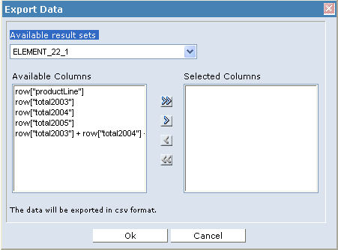
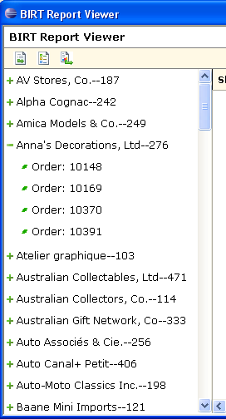
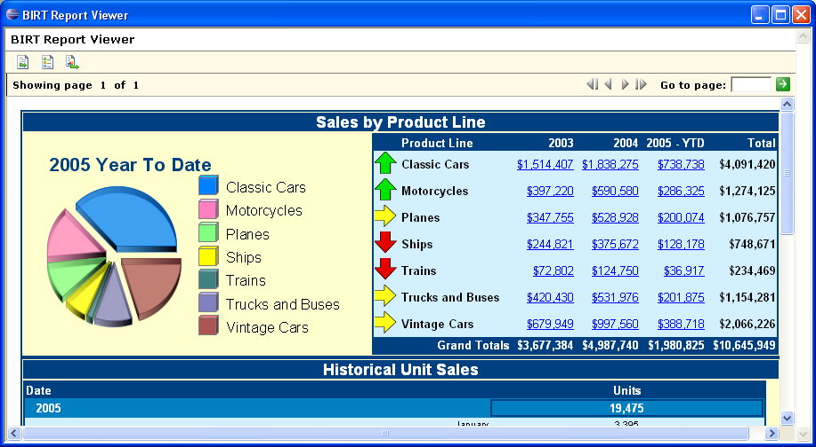
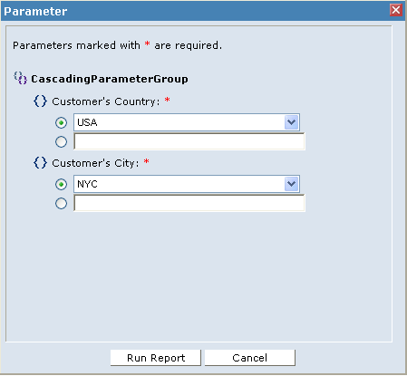
BIRT Viewer

Slide 23
BIRT APIs
Report Engine API – Loads and executes design files.
Design Engine API – Creates and modifies report designs.
Charting API – Builds and renders charts.

Slide 24
Report Engine API
Used to integrate run-time portion of BIRT into your application.
Used to discover and set parameters.
Run a report and output PDF/HTML.
Split Run and Render Task
Save to Intermediate format.
Extract data.
Fetch an image or chart for a report.
2.0 Engine supports additional features for paging, cascaded and dynamic parameters, etc.
Example in the runtime download.

Slide 25
Engine API
EngineConfig
Set configuration variables such as Engine Home and Log configuration
Open Report Design and Documents. Create Engine Task.
ReportEngine
Generate one or more tasks
DataPreviewTask
Execute Report Data Sets
GetParameterDefinitionTask
Retrieve Parameters and their properties
RunAndRenderTask
Generate HTML or PDF Document
DataExtractionTask
Retrieve TOC, CSV, Bookmarks etc
RunTask
RenderTask
Generate Paginated HTML or PDF Document
RptDesign
XML
Design File
RptDocument
Report
Document
RptDesign
XML
Design File
RptDocument
Report
Document
RptDesign
XML
Design File
RptDocument
Report
Document

Slide 26
Report Engine API
EngineConfig – Set options for the report engine.
ReportEngine – Used to run one or more Report Task
  IGetParameterDefinitionTask
  IRunAndRenderReportTask
  IDataPreviewTask
  etc
IReportRunnable – Used to open a report and pass to the RunAndRender task. Handle to the report design.
HTMLRenderContext – Defines render context. Used for image and action handling, ie Image locations.
HTMLRenderOption – Set options such as output location, format, embeddable etc.

Slide 27
Report Engine Pseudo
EngineConfig config = new EngineConfig();
  //setup config
  ReportEngine engine = new ReportEngine( config );
  //open report and create a run task
  design = engine.openReportDesign( designName );
  IRunAndRenderTask task =engine.createRunAndRenderTask( design );
  //set image dirs
  HTMLRenderContext renderContext=new HTMLRenderContext();
  //configure rendering options
  HTMLRenderOption options = new HTMLRenderOption();
  task.setRenderOption(options);
  //run report
  task.run();

Slide 28
Design Engine API
Create and modify report designs.
Create and delete report elements.
Put report elements into slots.
Get and set parameter values.
Retrieve metadata from report elements, properties and slots.
Undo/Redo
Semantic Checks on report designs.

Slide 29
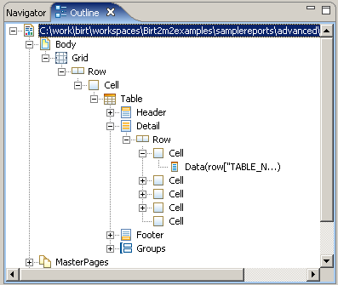
Design Engine API
Elements – Report Objects such as Table, Label, Style etc.
Properties – Modify the Element state and often support inheritance. Discussed in ROM specification.
Slots – Describes element - container relationships. For example a Report element contains slots for Data Sources, Data Sets, Report Body, etc.

Slide 30
Design Engine API
SessionHandle – Used to open one or more designs.
ReportDesignHandle – Handle to specific report design.
ElementFactory – Creates new report elements
DesignElementHandle – Handle to created element.
  GridHandle, RowHandle, CellHandle, etc
SlotHandle – Handle to a Slot. Used to add element to design, using add method.

Slide 31
Design Engine Pseudo
  SessionHandle session = DesignEngine.newSession( null );
  // Create a new report design.
  ReportDesignHandle design = session.createDesign( );
  // setup element factory
  ElementFactory factory = design.getElementFactory( );
  // Create a simple master page
  DesignElementHandle element =
  factory.newSimpleMasterPage( "Page Master" );
  //Get SlotHandle and add element
  design.getMasterPages( ).add( element );
  //Save and close report design
  design.saveAs( "c:/work/temp/JavaPolis.rptdesign" );
  design.close( );

Slide 32
BIRT Chart Engine API
Stand Alone Chart Generator
Does not require the use of the Chart User Interface
Does not require the use of the Report Engine API
Data is provided in a static data structure
  When Charts render in Reports, Report Engine builds static structure from the specified ODA data and creates the static structure
  Charts running stand-alone require a data feed
    org.eclipse.birt.chart.datafeed-Custom User Data Set Interface
    org.eclipse.birt.chart.model.data-Interfaces defines data structure
JavaScript events support addition of custom business logic

Slide 33
BIRT Extensions Points
BIRT is not just a tool but a framework.
Predominant Extension Points.
  Emitter
  ODA – DTP
  Report Item
  Chart Types

Slide 34
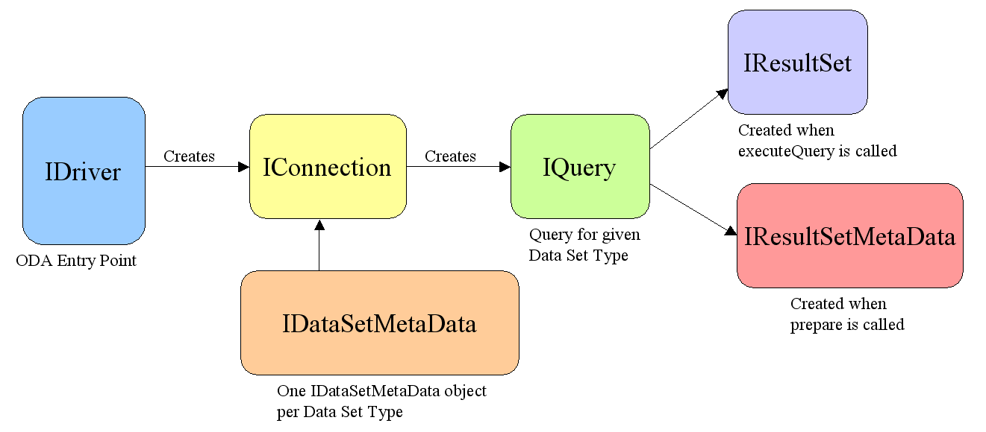
BIRT/DTP Extension Points Example
  <dataSource
  odaVersion="3.0" driverClass="org.eclipse.birt.report.data.oda.hibernate.HibernateDriver"
  defaultDisplayName="Hibernate Data Source"
  id="org.eclipse.birt.report.data.oda.hibernate"
  setThreadContextClassLoader="false">
  </dataSource>

Slide 35
Where to Learn More
http://www.eclipse.org/birt
http://www.eclipse.org/birt/phoenix/examples
http://www.eclipse.org/birt/phoenix/ref
http://Birtworld.blogspot.com
Very active Newsgroup

Slide 36
Q&A

